Slide 1
HTTP Request Life Cycle
Gugan RB
gugan.balamurugan@aspiresystems.biz

Slide 2
HTTP Request Life Cycle
Web Browser submits the request to the server after creating a socket in local progress.
The http server waits for the request to come on socket .
The web browser translates the google.com to an IP address if it does not knows it.
If the web browser does not recognize the address it contacts a DNS Server to resolve the name.
The browser will open a TCP connection to the IP address of google.com and send a HTTP GET request over.
The request is then submitted to DNS server where IP address is fetched based on domain name.

Slide 3

HTTP Request Life Cycle
Now the request is submitted to Http Server as per HTTP protocol.
Http server receives the request and shifts the client to another socket.
So the socket on port-80 is released to receive request from other clients.
Web Browser & server both are connected to each other.
The server will process the request, renders the response & breaks the connection.
Notes:
This slide is only for the trainer… You can display the poll from GTM and after the poll is taken, share the result, connect the poll result with the topic. Once done, you can hide the poll so that the PPT is visible.
I have created the poll in the GTM webinar.

Slide 4
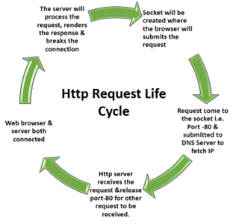
HTTP Request Life Cycle

Slide 5


